Slide 1
Advancing Tensor Data Analysis: The Generalized Multilinear Model (GMLM)
Carlos Llosa,
Danny Dunlavy, Jeremy Myers, Rich Lehoucq, Tian Ma
Sandia National Laboratories, USA
SAND2025-12497PE

Slide 2
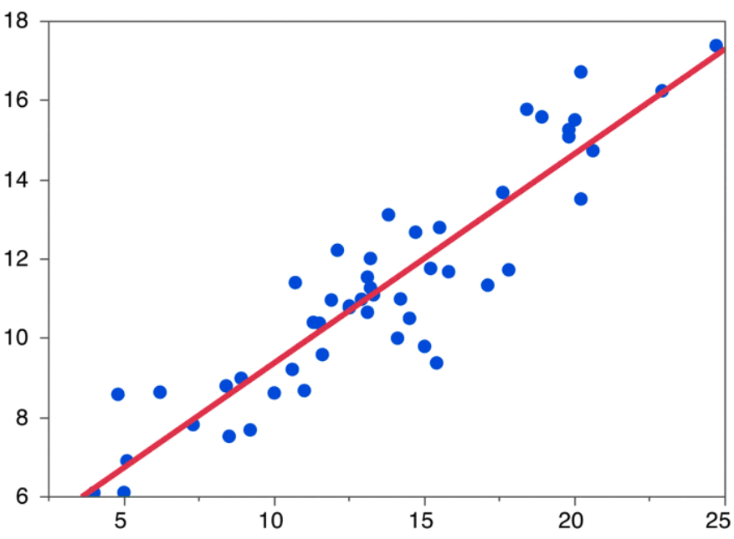
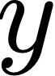
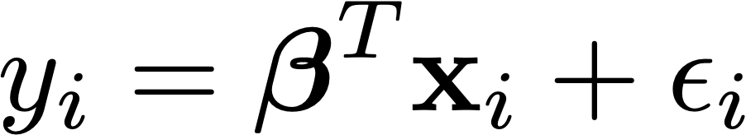

Linear Regression
Simple linear regression:
Multiple linear regression:
responses
covariates

Slide 3
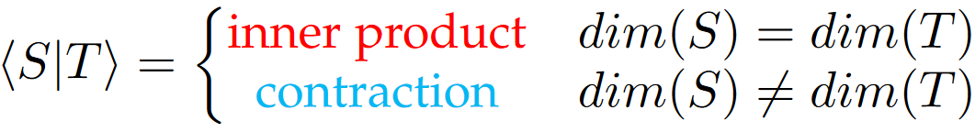
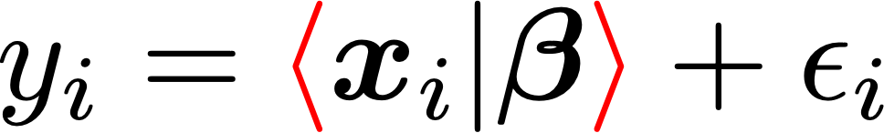
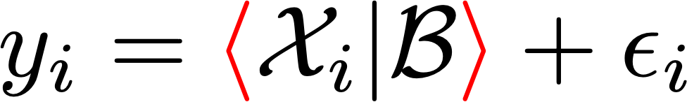
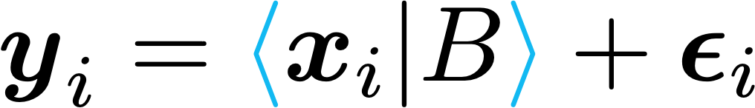
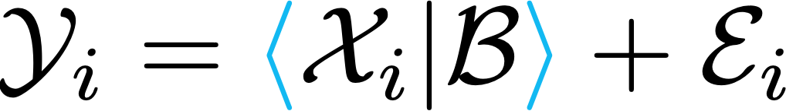
Tensor-ON-Tensor Regression
Linear regression:
Tensor regression:
Multivariate linear regression:
Tensor-on-Tensor regression (ToTR):
Lock (2018); Llosa & Maitra (2022)

Slide 4
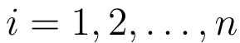
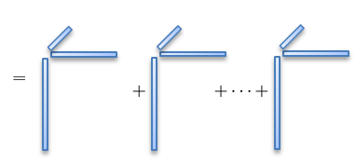
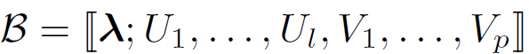
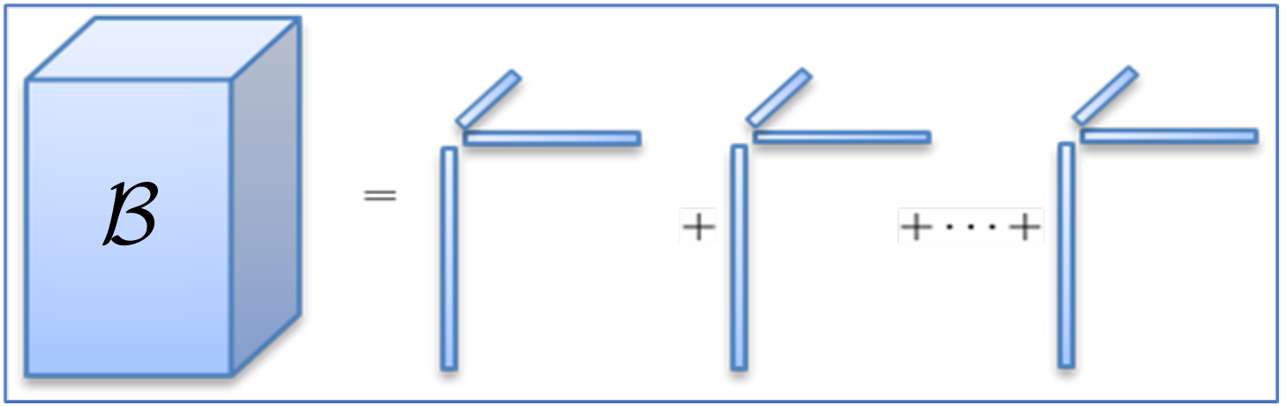
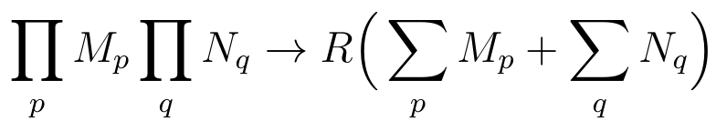
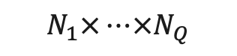
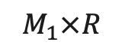
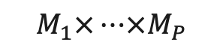

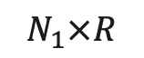
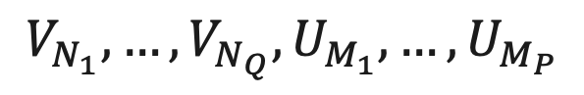

TOTR: How Much Data Do We Need to Fit the Model
$$M_{1}×…×M_{P}$$
$$N_{1}×…×N_{Q}$$
Tensor-on-Tensor regression (ToTR):
so many samples needed!
$$N_{1}×…×N_{Q}×M_{1}×…×M_{P}$$
Low-rank Canonical Polyadic (CP) Model:
$$N_{1}×R$$
$$M_{1}×R$$
Rank-1 tensor
$$V_{N_{1}},…, V_{N_{Q}}, U_{M_{1}},…,U_{M_{P}}$$
Fewer parameters fewer samples needed
Lock (2018); Llosa & Maitra (2022)
$R$ summands

Slide 5
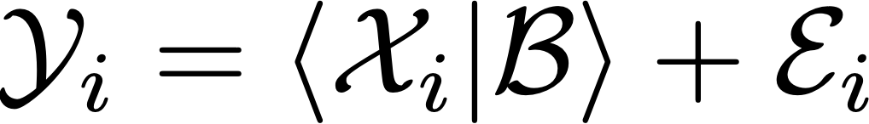
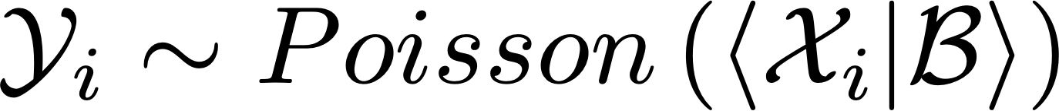
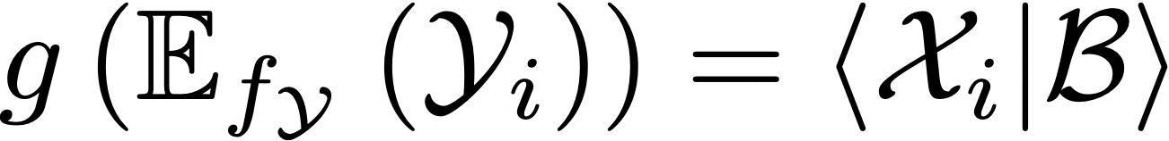
Generalizing Tensor-ON-Tensor Regression
$$M_{1}×…×M_{P}$$
$$N_{1}×…×N_{Q}$$
Tensor-on-Tensor regression (ToTR):
$$N_{1}×…×N_{Q}×M_{1}×…×M_{P}$$
ToTR
Poisson ToTR (PToTR)
GMLM
Lock (2018); Llosa & Maitra (2022)
Llosa & Dunlavy (2025)
Llosa, Dunlavy, Myers, Lehoucq & Ma (2025)
CP, Tucker, Tensor Train, Tensor Network, …
CP
CP

Slide 6
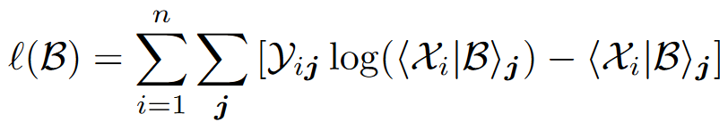
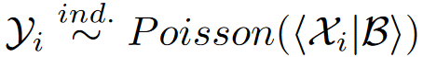
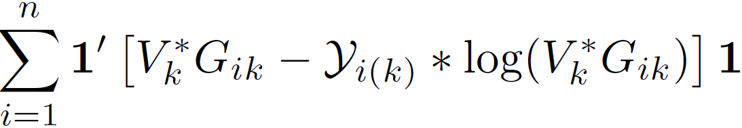
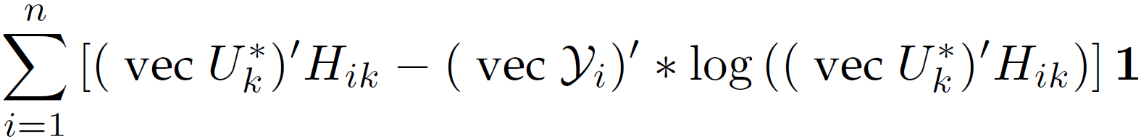
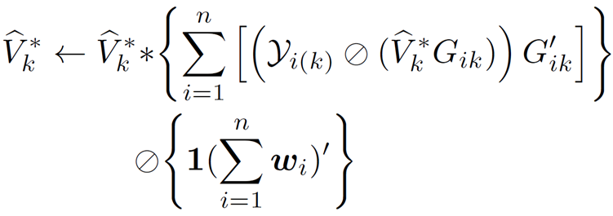
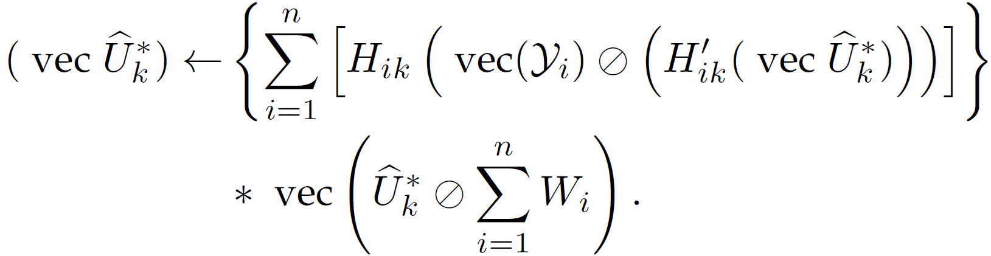


PToTR: Parameter Inference via Maximum Likelihood Estimation
Model
Loglikelihood
Constraints
> 0
New multiplicative update rules extend those in the CP-alternating Poisson regression (CP-APR) algorithm [1]
Estimation of $V_{k}$
Estimation of $U_{k}$
Alternative expression for Loglikelihood:
Multiplicative update:
(non-decreasing loglikelihood)
[1] Chi & Kolda (2012)
Takeaway: Alternating method possible for more challenging PDF

Slide 7
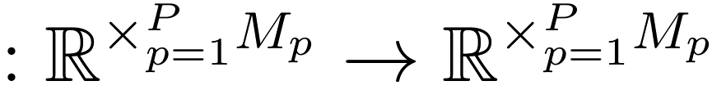
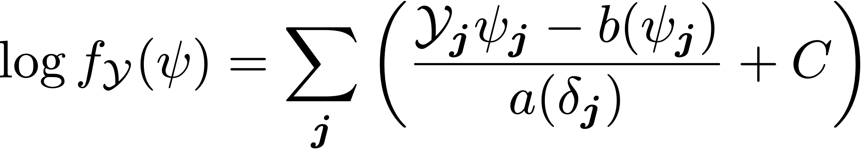
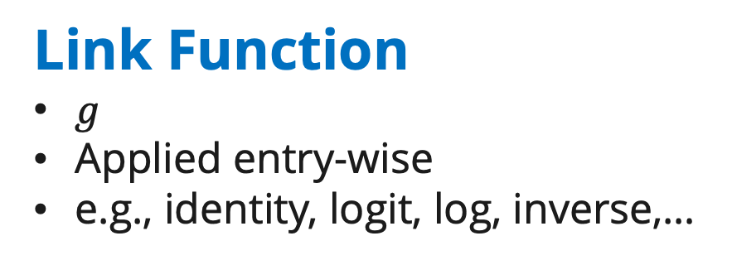
The Generalized Multilinear model (GMLM)
Same as in ToTR
Link Function
$g$
Applied entry-wise
e.g., identity, logit, log, inverse,…
Random component
Exponential dispersion family:
e.g., normal, binomial, Poisson, …
Extends the Generalized Linear Model (GLM) to tensors
Nelder & Wedderburn (1972)

Slide 8
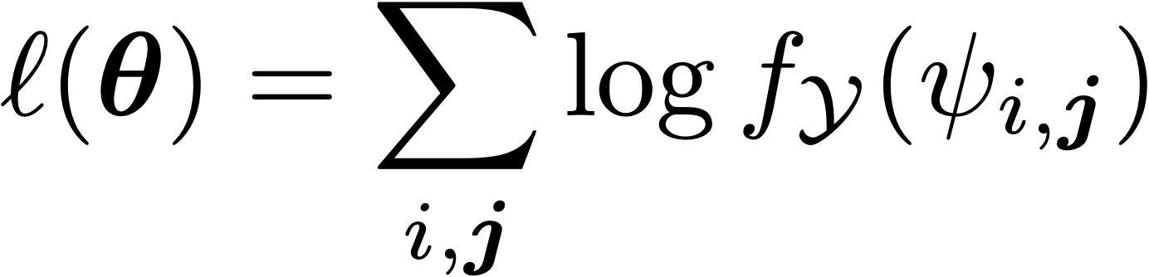
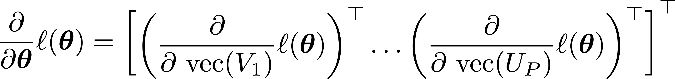
From GLM to GMLM
Low-rank constraint:
Loglikelihood:
Gradient:

Slide 9
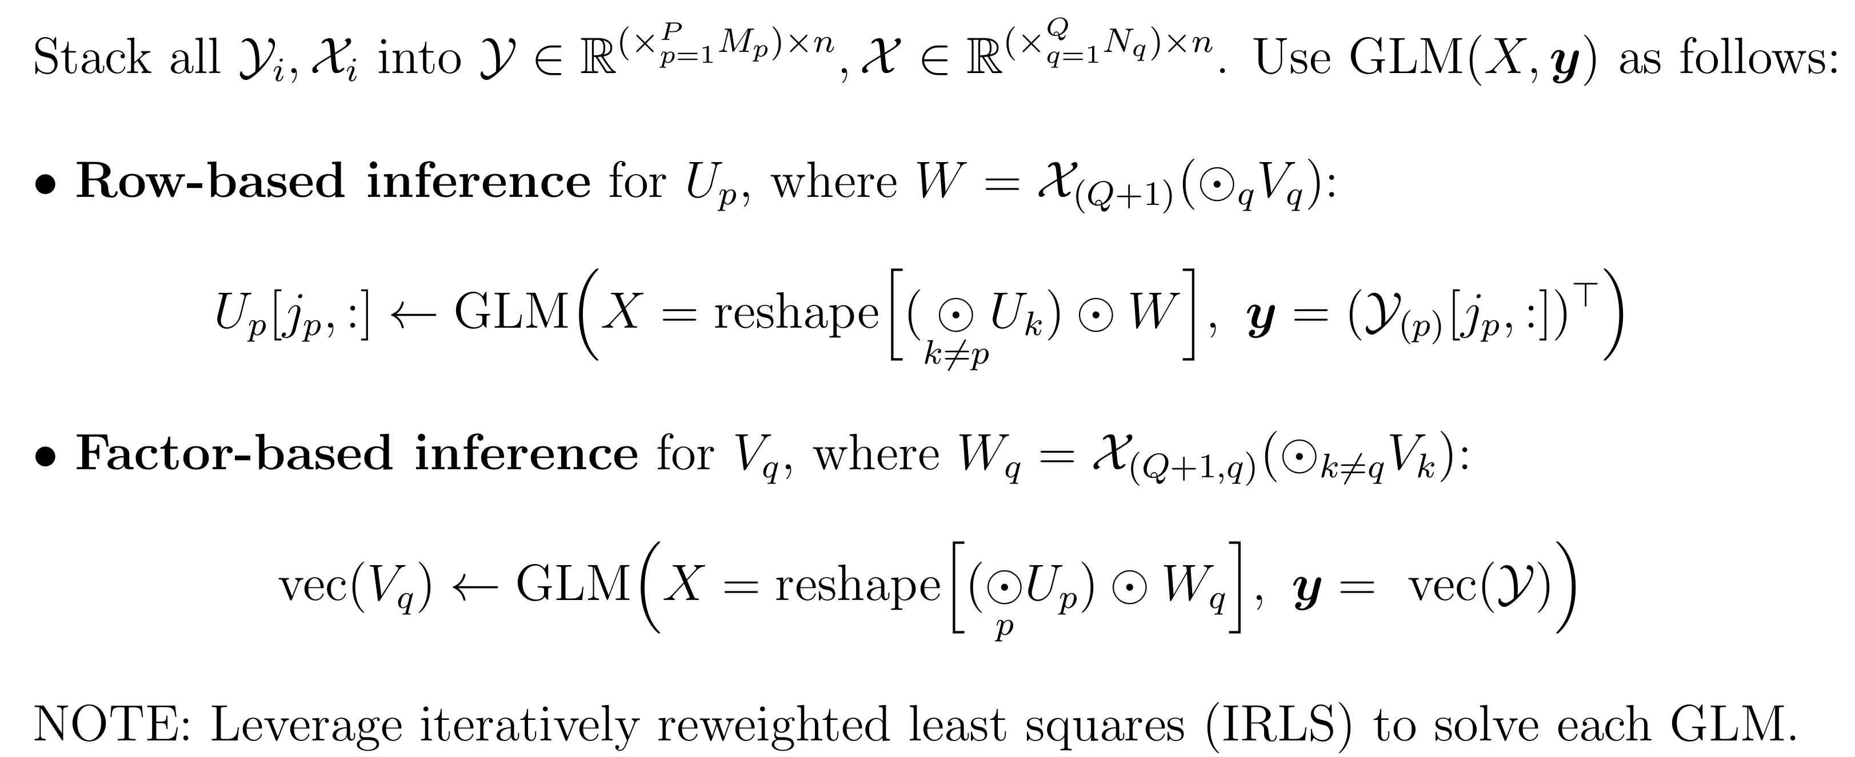
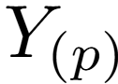
GMLM: Maximum Likelihood Estimation
Khatri-Rao Product
1 outer iteration

Slide 10
Example Applications

Slide 11
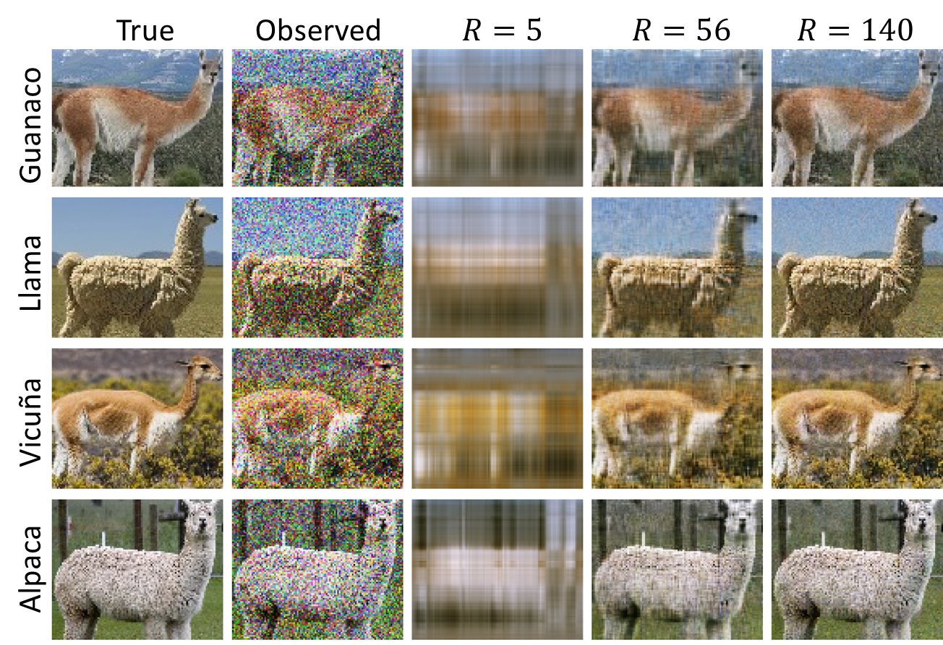

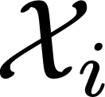
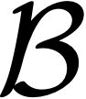
Parameter Inference Validation: Simulated Data
Gaussian distribution, identity link:
4 different camelid images
150 noisy samples of each
: 87 x 106 (pixel height x width)
: 4 x 3 (camelid x RGB channel)
: 4 x 3 x 87 x 106
Can recover original images from noisy samples using GMLM with sufficiently high rank of parameter tensor.

Slide 12
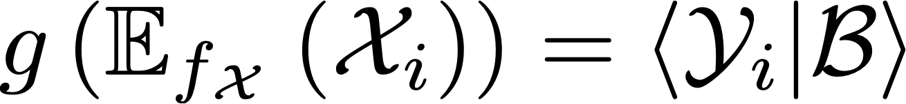
Image Classification (Prediction): Simulated Data
Binomial distribution, logit link:
4 different camelid images
150 noisy samples of each
: 87 x 106 (pixel height x width)
: 4 x 1 (camelid x RGB channel)
: 87 x 106 x 4 x 1
Can accurately predict image classifications from noisy samples using GMLM with sufficiently high rank of parameter tensor.

Slide 13
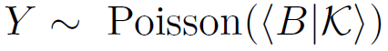
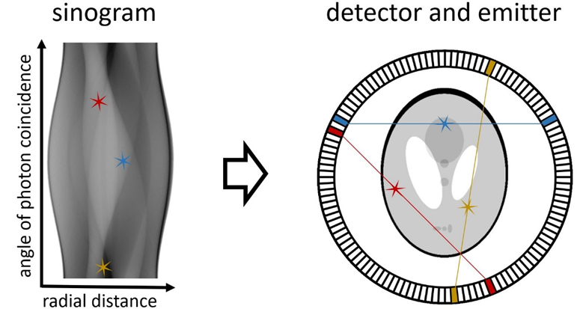
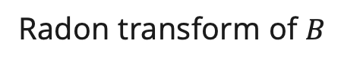
positron emission tomography Image reconstruction
Element-wise regression (ML-EM) [1]:
Ill-posed without constraints [2]
NEW: Poisson-response Tensor-on-tensor regression (PToTR):
Recovers full image and is well-posed due to use of low-rank model for
Radon transform of $B$
Observed sinogram
containing counts
Image to reconstruct
[1] Shepp & Vardi (1982); [2] Snyder, Miller, Thomas & Politte (1987)

Slide 14
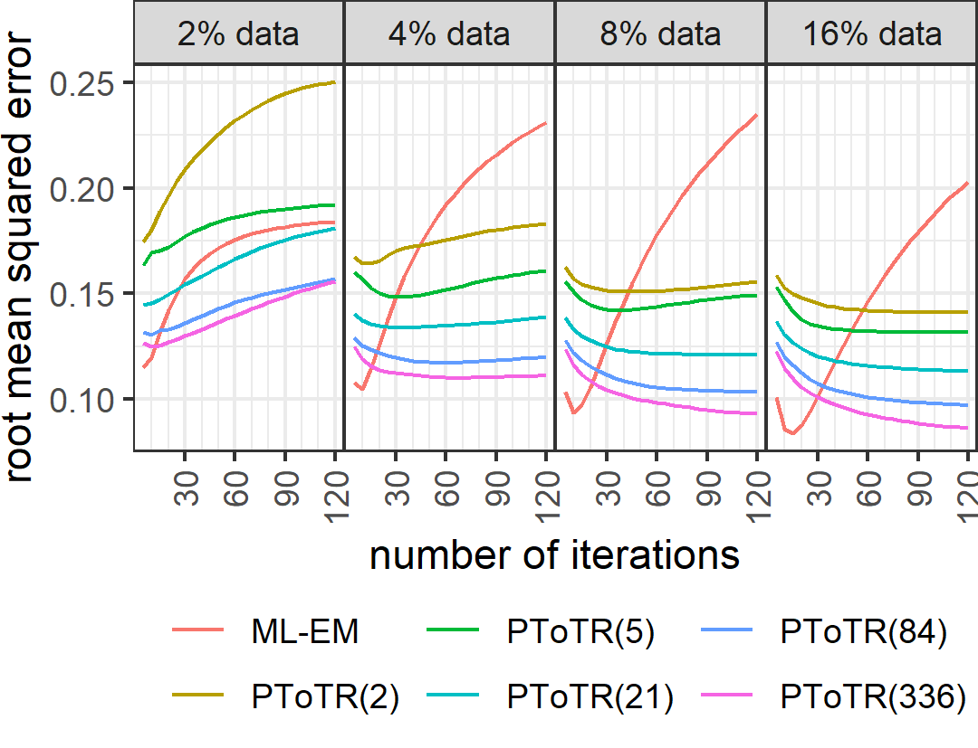
positron emission tomography reconstruction
4-way tensor data: four MRI measurements on the same subject and scanner
256 x 256 matrix slices → 256 x 1024 sinograms
Parameters: ML-EM (no low-rank): ~ 63 million; GMLM: ~ 63 thousand (rank-84)
Hawco, et al. (2022)
ML-EM
GMLM(84)
GMLM(5)
GMLM(84)
GMLM(336)
GMLM(2)
GMLM(21)
GMLM(336)

Slide 15
GMLM: Generalized Multilinear Model
Carlos Llosa cjllosa@sandia.gov

